Slide 1
Tropicalization of US fisheries catches
Donna Dimarchopoulou^{1,2}, Jesús Pineda¹, Rubao Ji¹, Boris Worm², Heike K. Lotze²
⁽¹⁾ Woods Hole Oceanographic Institution, Biology Department, Woods Hole, MA, USA
⁽²⁾ Dalhousie University, Biology Department, Halifax, NS, Canada

Slide 2
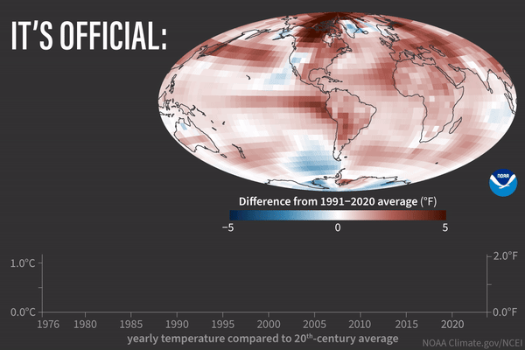
Introduction
Notes:
CO₂ and other greenhouse gases emissions - burning fossil fuels and deforestation

Slide 3

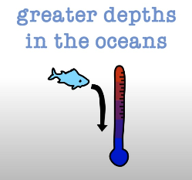
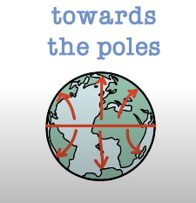
Introduction

Slide 4
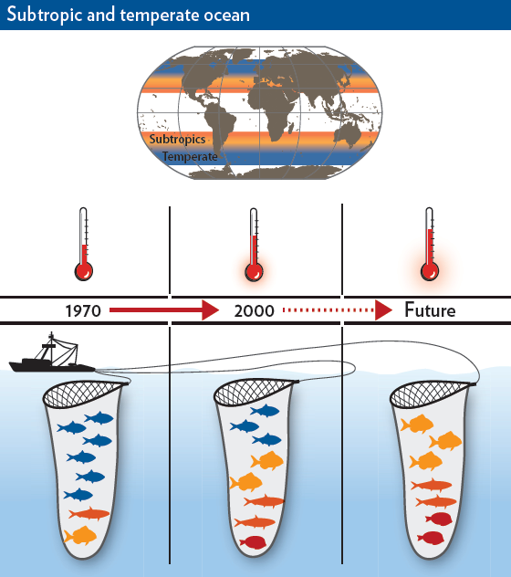
Introduction
(Cheung & Pauly 2016)

Slide 5
Methods
Mean temperature of the catch
the average temperature preference of exploited fish & invertebrates weighted by their annual catch

Slide 6
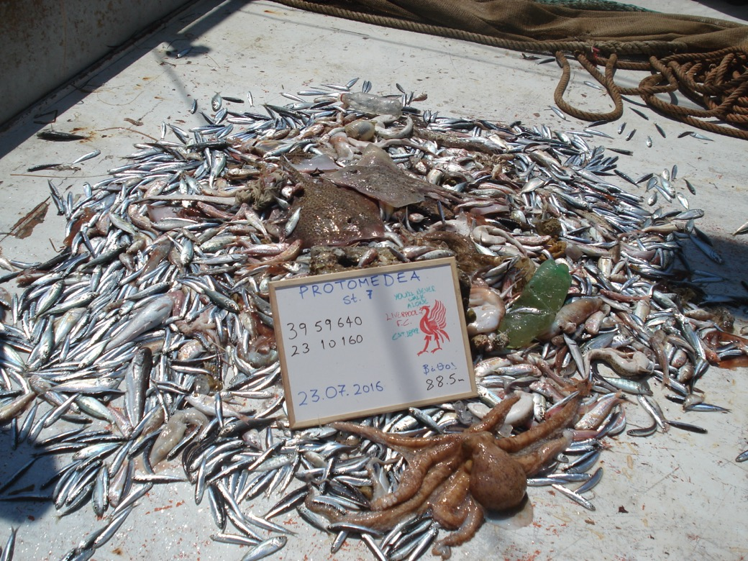
Methods
Mean temperature of the catch
the average temperature preference of exploited fish & invertebrates weighted by their annual catch

Slide 7
Methods
Preferred temperature
Engraulis encrasicolus = 12.4 ºC
Preferred temperature
Mullus barbatus
= 14.2 ºC
Preferred temperature
Octopus vulgaris
= 21.2 ºC
Preferred temperature
Merluccius merluccius = 12.6 ºC

Slide 8
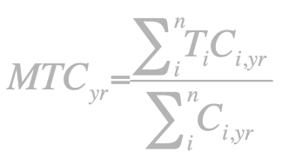
Methods
Preferred temperature
Engraulis encrasicolus = 12.4 ºC
Preferred temperature
Mullus barbatus
= 14.2 ºC
Preferred temperature
Octopus vulgaris
= 21.2 ºC
Preferred temperature
Merluccius merluccius = 12.6 ºC

Slide 9
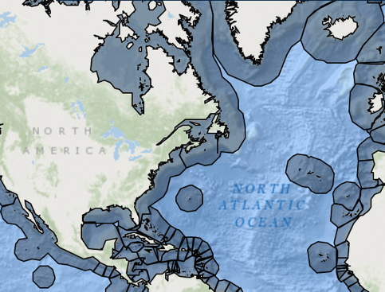
Methods
Notes:
Atlantic and Gulf of Mexico – 28% of landings, 55% of value of US fisheries (rest is Alaska and Pacific)

Slide 10
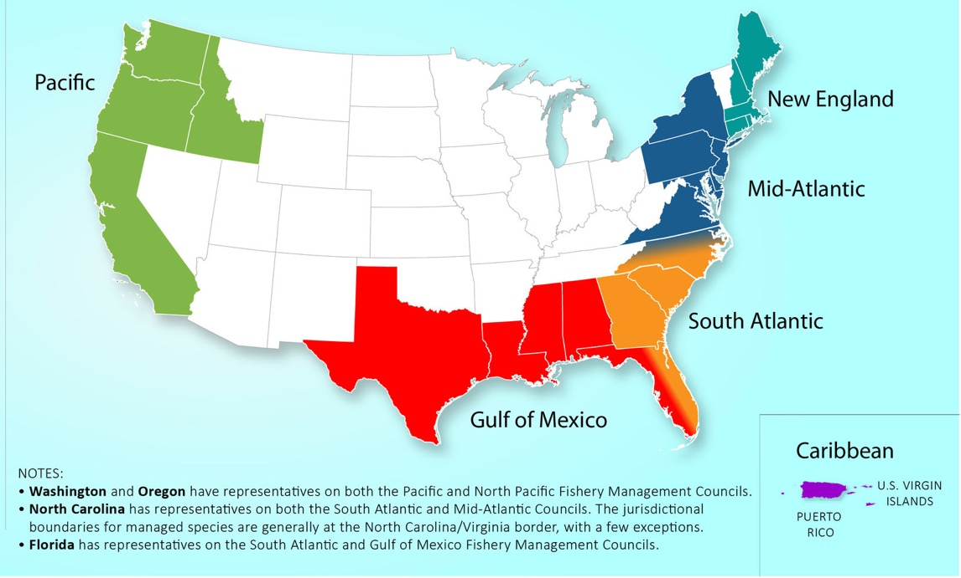
Methods
U.S. Regional Fishery Management Councils

Slide 11
Methods
U.S. Regional Fishery Management Councils
Data
fisheries catches, SST, preferred temperature

Slide 12
Results & Discussion
New England
Notes:
0.2 ºC / decade

Slide 13
Results & Discussion
New England
Middle Atlantic
Notes:
0.1 ºC / decade

Slide 14
Results & Discussion
New England
Middle Atlantic
South Atlantic
Notes:
0.5 ºC / decade

Slide 15
Results & Discussion
New England
Middle Atlantic
South Atlantic
Gulf of Mexico
Notes:
0.1 ºC / decade

Slide 16
Results & Discussion
New England
Middle Atlantic
South Atlantic
Gulf of Mexico

Slide 17
Results & Discussion

Slide 18
Results & Discussion

Slide 19
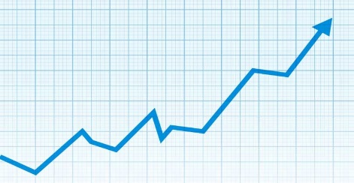

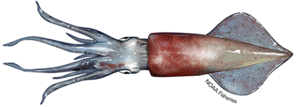
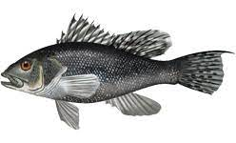
Results & Discussion
New England
Notes:
Longfin squid, black sea bass (24, 21 degrees C)

Slide 20
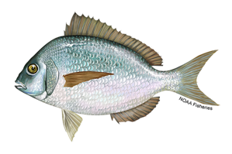
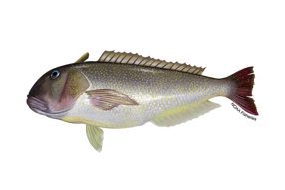
Results & Discussion
New England
Middle Atlantic
Notes:
Scup, golden tilefish (20, 19 degrees C)

Slide 21
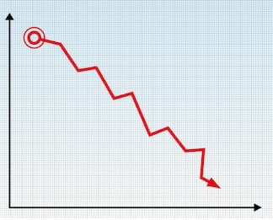

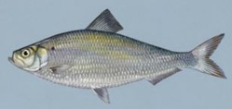

Results & Discussion
New England
Middle Atlantic
South Atlantic
Notes:
Alewife, Atlantic herring (8, 8 degrees C)

Slide 22
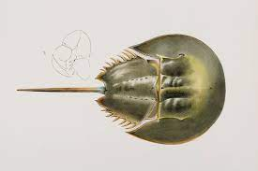
Results & Discussion
New England
Middle Atlantic
South Atlantic
Gulf of Mexico
Notes:
Horseshoe crab, alewife (16, 8 degrees C)

Slide 23

Conclusions
Tropicalization of US fisheries catches

Slide 24
Conclusions
Tropicalization of US fisheries catches
Fishers: new species – new locations

Slide 25
Conclusions
Tropicalization of US fisheries catches
Fishers: new species – new locations
Consumers: new species – elevated prices

Slide 26
Conclusions
Tropicalization of US fisheries catches
Fishers: new species – new locations
Consumers: new species – elevated prices
Dynamic, adaptable management strategies
Notes:
Method caveats: how catch data might affect the results and thoughts on handling the issue, how survey data would work etc.

Slide 27
